Slide 1
Volunteer Orientation Training
PMI Mumbai Chapter
Hari P Thapliyal, PMP, MCITP, MCA, MBA
Vice President- Volunteer Development

Slide 2
Agenda
About PMI Mumbai Chapter
PMI Mumbai Chapter Objective & Services
PMI Mumbai Chapter Board of Directors & Responsibilities
What we do?
Why Volunteer?
Who Volunteer?
How Volunteer?
What to Do?
Recognition & Volunteer Path
Do’s & Don'ts
Expectations & Ground Rule
Meetings & Events @ PMI-MC

Slide 3
About PMI Mumbai Chapter (PMIMC)

Slide 4


About PMI Mumbai Chapter (PMIMC)
NON-PROFIT ORGANIZATION
LOCATION
  Mumbai
AREA OF OPERATION
  Western India.

Slide 5

History
September 25, 1998 – First Members Meeting
1998/99 – Formation Application for “Western India Potential Chapter
May 2001- Chapter Accredited as ‘PMI Mumbai Chapter’
First group of committed Project Management Professionals lead by Mr. Ramesh Joshi
Main principle: Give strong support to PMI in their defined purpose of dedication to advancing the state of art in project management
Our website: http://www.pmimumbaichapter.org

Slide 6
Vision & Mission
VISION
  To be recognized as the organization of choice by evangelizing Project Management.
Missions
  Evangelize project Management across industry, academia, community and government.
  Provide a forum for project management professionals to promote the principles and ethical standards of PMI.
  Promote networking among professionals, sharing project experiences and best practices, imparting training and enabling PMI certifications and ultimately enhancing quality of life.
  Provide infrastructural facilities like library, portal and knowledge repositories.

Slide 7
Objective & Services

Slide 8
Objective of PMI
Provide knowledge and tools with great service
Strengthen stakeholder loyalty
Demonstrate benefits from project management
Thought leadership
Profession enablers
Partnering
Advocacy
Make PMI a customer centric organization
Make leadership excellence a strategic competency
Make market and business develop-ment a strategic competency
Leverage resources / investments in the marketplace
Maintain financial viability

Slide 9


Core Services & Extension Services
Membership Retention
Membership Satisfaction
Component Events
  Monthly meetings / Annual conferences
Component Customer Centricity Program
  Component web site
  Communication with members via newsletter and/or email
  Recognition for new members and/or credentials earned by members
  Marketing introduction and benefits package
  Member Satisfaction with benefits package
Component Leadership Dev. Program
  Transition/Orienting new leaders
  LIM or regional leadership meeting attendance
  Strategic planning meeting to review strategic alignment and business plan
  Conduct Satisfaction Survey
  Complete Strategic Alignment Scorecard Report

Slide 10
PMI Mumbai Chapter Board of Directors
And Responsibilities

Slide 11
Responsibilities: President
The President is chief executive officer for the Chapter and of the Board, making all required appointments with the approval of the Board, serve as a member ex-officio with the right to vote on all committees except the Nominating Committee
Strategic planning and guiding
Maintaining and growing relationship with PMI
Statutory and Regulatory compliance
Invite key influencers from industry to participate in component events in consultation with VP – Corporate relations
To interact with ethics committee.
Volunteer Development
Financial Viability

Slide 12
Responsibilities: Vice-President - Finance
Vice President –Finance keeps the records of all business meetings of the Chapter and meetings of the Board, oversee the management of funds for duly authorized purposes of the Chapter
Finance
Legal
Human Resources
Insurance
Procurement
Administration related activities

Slide 13
Responsibilities: Vice President - Membership
Increase and retain members
Pursue unpaid members for collection and retention purposes.
Provide periodic membership lists to all Committee members, communicating with and requesting from PMI, all appropriate membership documentation.
Compile and maintain a current file of PMI members in the Chapter area of operations and solicit their affiliation with the local Chapter.
To study and address membership attrition and retention
To act on information and reports available on DEP provided by PMI HQ.
To develop a welcome kit for new members
Communicating and recognizing new members and new PMI credential holders
Create a marketing introduction and benefits package for attracting new members
*Current VP Communication is performing the activities of this position

Slide 14
Responsibilities: Vice President- Communication
Create and maintain “Calendar of Events”
Publish various networking opportunities.
Create discussion groups and moderate them.
Maintain and update chapter database for the Chapter communications.
Communication to conduct surveys with all the members
Maintain and update chapter website
Announce employment vacancies / opportunities to members via community's events, newsletter, subscribed email groups or its Web site.
The community provides a facility for members to posting their resumes that can be reviewed by potential employers

Slide 15
Responsibilities: Vice President- Publication
Fill the role of Project Manager establishing volunteer committees for the preparation and editing of periodical newsletters and journals, published articles, and local advertisements describing Chapter activities and plans.
Publish various networking opportunities.
Publish soft-skill success stories in component newsletters.
Provides some or all of the following to the chapter members: Articles, white papers, presentations, best practices, research papers, case studies, frequently asked questions (FAQs), glossary of terms and acronyms, processes, procedures, templates, or tools to members via newsletters, web site, journal, e-mail, or presentations.

Slide 16
Responsibilities: Vice President- Certification Training
Establish and oversee a volunteer group charged with the task of developing and delivering a certification examination preparation workshop to be offered periodically.
Establish and maintain a chapter library of project management reading material and professional publications.
Co-ordinate and maintain certification preparation workshop modules to insure they reflect the types of changes being made to the PMI certification test.
Identify and procure certification tools such as test software for use by prospective certification candidates.
Establish, develop and deliver various courses on different project management related topic approved by BOD with our own in-house faculties and material on periodic basis.

Slide 17
Responsibilities: Vice President- Programs
Participate in joint meetings or conferences with other industry associations.
Conduct a professional development event for members and non-members.
  The community provides an event for the sole purpose of allowing members to get together to meet each other. For example: Golf day, Reception at PMI Congress.
  Published various networking opportunities in newsletters and on the communities web site. These could include events handle by REPs, other professional organizations, neighboring chapters, and PMI.
Invite key influencers from industry / individuals to participate in component events as speakers such as IPM day program or other programs.
Hold collaborative, inter-component meetings
Advocacy – champion project management methodology among members.

Slide 18
Responsibilities: Vice President- PMPClub
Hold a professional development event for members and non-members.
Create discussion groups on Web sites and moderate those groups
Conduct networking events on regular basis such as PMP club event.
Manage the web site to have a link to the Virtual Library in an easy to find location. Along with the link, is a brief description of the Virtual Library and the value that members can received from the Center

Slide 19
Responsibilities: Vice President- Branches
Deliver PMI & PMI MC products and services at branch level
Tracking and follow up process after meetings with branches
Serve needs of members within a geographic area of a chapter that is not served easily by the chapter
Provides face to face events that are easier to attend (closer to their home or office) or in an area of specialized interest (for ex. LIGs).
Join hands with academic institutions such as universities, colleges, etc. for spreading the knowledge of Project Management among the students
Interact with academia to offer PMI accredited courses / programs to the students

Slide 20
Responsibilities: Vice President- Corporate Relation
Involve members above the operational management level of organizations.
Provide outreach to local organizations and educate them on the value of project management.
Invite key influencers from industry to participate in the chapters corporate council.
Interact, quote, negotiate and finalize proposals for Corporate training, sponsorship, etc.
Facilitate round table events which brings together industry leaders to discuss various project management topics.
Manage a local Executive Advisory Board or similar group where local executives can meet and discussion project management topics.
Manage a formal sponsorship process

Slide 21
Responsibilities: Vice President- Volunteer Development
Encourage individuals to volunteer to participate in the updates and extensions to the Professional PMBOK® Guide, standards and other professional programs.
Identify and develop new volunteers
Create and Manage a formal process for volunteer recognition at least once a year to recognize the community volunteers.
Creating and maintaining a formal process to develop community leaders to acquire the skills and knowledge to be an effective leader that compliments PMI Learn by addressing the needs for leaders.

Slide 22
Responsibilities: Chairperson- Ethics Committee
The ethics committee looks into the ethics related issues as envisaged by PMI.
Ethics committee comprise of chairman and few members.
The ethics committee chairman is ex-board member, so that s/he is aware of the functioning of the board.
The ethics committee member cannot be part of any other committee.
Along with chairperson of the ethics committee should:
      Lay down guidelines related to ethics to be followed by the BOD and chapter members.
      Should oversee that these guidelines are followed by the chapter members.
Initiate actions against chapter members who are not complying with the ethical guidelines.

Slide 23
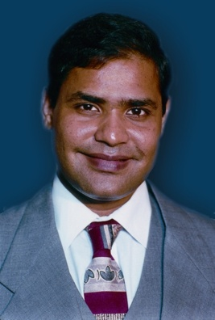



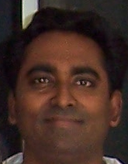
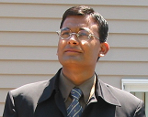
Current- President & Board of Directors
Tejas Sura,
President
R V Joshi
Founder, V.P. - Communications
CS Joshi,
VP Finance
Sharad Harale
V.P. – Certification Training
Rakesh Gupta
V.P. – Branches
Yagna Boorada,
VP PMPClub
Kumar Vaalsalam
VP-Publication
Madhav Prabhu,
VP Corporate Relations
Zubin Kika,
VP Programs
Hari P Thapliyal,
VP Volunteer Development

Slide 24
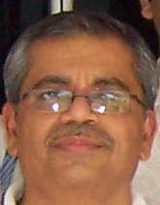
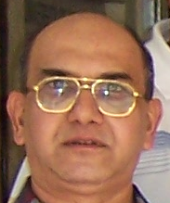

Advisors & Committee Chairs
D Y Pathak Advisor
Bharat Bhagat
Advisor
Kalyanraman Narayanswamy
Chair- Ethics Committee

Slide 25


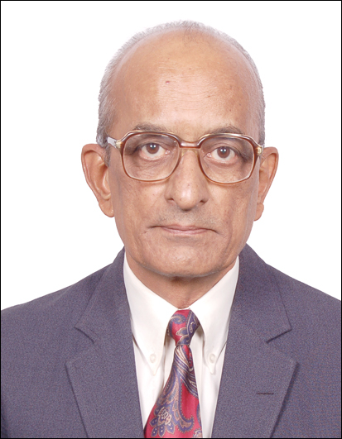

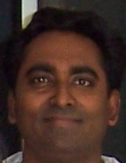



THE TEAM
Ramesh V. Joshi
Founder President, V. P - Communications
Sharad Harale
V.P. – Certification Training
Rakesh Gupta
V.P. – Branches
Tejas Sura
President
Chandrashekhar Joshi
V.P. - Finance
Zubin Kika
V.P. – Programs
Hari Thapliyal V.P. – Volunteer
Madhav Prabhu V.P. – Corp. Rel.
Yagna Boorada
V. P. – PMP Club
Kumar Vaalsalam
VP-Publication
D Y Pathak Advisor
Bharat Bhagat
Advisor
R C Goyal
VP-PMPClub

Slide 26
What we do?

Slide 27
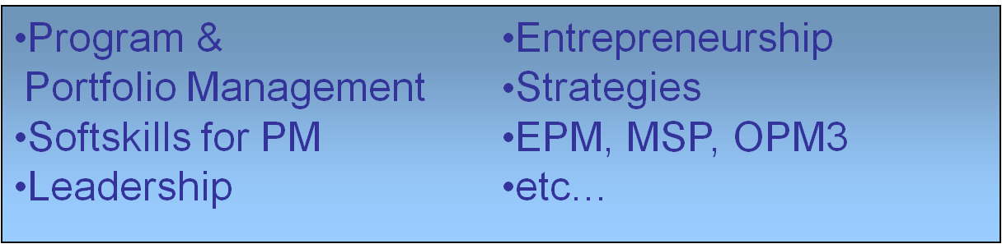


Networking
Monthly Networking PMP Club Meetings
  Over 50+ events
  100+ attendees
  Covering Hot Topics in Project Management

Slide 28
Education
PMP/CAPM Certification Examination Preparatory Courses
  60+ courses conducted
  1500+ Project Managers trained
  Faculty with Total Experience of 100+ years
  Corporate Training for Companies such as IBM, Accenture, Wipro , L & T Infotech, Coconut Software, AryaCom
Exam Simulation Software
PM for NGOs
Ongoing Development of New Courses such as MS Project, etc.
Library
  100+ Titles on Project Management
  Continuous up gradation with new titles

Slide 29
Conferences & Seminars
Conferences & Workshops
  Conference on Quality in Project Management, CQPM 2007
  International Project Management Day, IPM 2008
  Various Seminars on interesting topics from Leadership to Project Management for Aerospace, DPC/EPC, IT Companies, etc.

Slide 30
Publication
  Quarterly Journal - Prakalp
  Papers by Local PMs
  Update on Events

Slide 31
Geographical Expansion
  Ahmadabad activities since Nov. 2007
  Student Branch at MPSTME and other institutes
  Talks on for Branches at Nagpur, Jamnagar
  Looking at Potential Locations such as Navi Mumbai
  Looking for Leaders to form LIGs

Slide 32
Associations
  Other PMI Chapters of India
  International PMI Chapters such as Washington D.C., Tokyo
  Computer Society of India
  Bombay Management Association
  Institution of Engineers

Slide 33
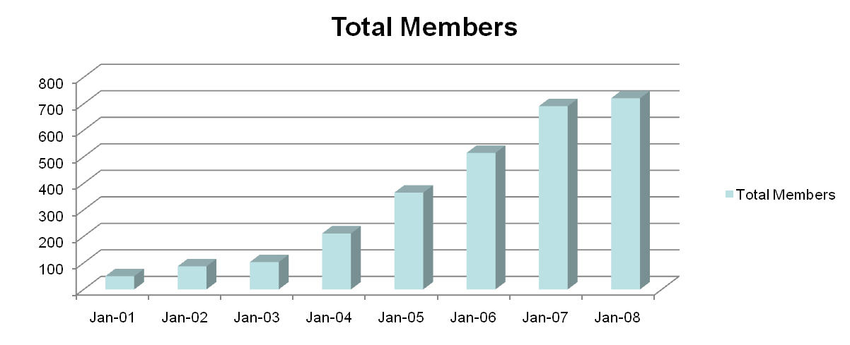
Membership & Growth
Membership & Growth
  Current count 725+
  Highest Growth Rates amongst Regional Chapters

Slide 34
Why Committed & Effective Chapter Leaders Required?
To take chapter to a higher maturity level
To achieve the goals
To make the plan and systematically track it
Create a big group of leaders
Keep team excited and motivated all the time
Marketing and realization of purpose and efforts done by team for the society
Etc………..

Slide 35
Why People Volunteer?
  Professional/Personal Development
  Contribution to a “greater good”
  Sense of belonging to a “community”
  Connecting to the same mindset people

Slide 36
Why People Don’t Volunteer?
  Afraid of how much time is required
  Do not know what need to be done
  Is it worth to spend time for society or NGO?
  Watched others “burn out” in the positions
  Worry they’ll be left holding the bag if others don’t do their jobs
  Won’t know how to extricate themselves

Slide 37
Why you may to Volunteer?
Professional
To gain leadership skills
To be challenged
To strengthen resume
To use skills don’t use on job
To earn PDU’s toward recertification
To do something different than daily job
Power/Influence
To share skills, knowledge
To have an impact
Recognition/ Praise
To gain added recognition, status
To get Brownie points at work
Accomplishment
To gain satisfaction & gratification at results
Interpersonal
To be a part of a team
To interact with many different people
  who share interests
To make new friends
To have fun
To feel needed
Because they are asked
Because of who does the asking
Affiliation
To demonstrate a commitment
Because of personal interest
To feel like part of the solution
To gain in depth understanding of organization
To become an “insider”
To gain access to services for themselves

Slide 38
Who Can Become Volunteer?
Love for people, enthusiastic, sincere, good communication skills
Believe in the values of chapter and enjoy working in the team
Passionate to learn new things and make new friends
Respect and recognize other’s work
Have patience! Sometime results are delayed so keep focus clear and think farther and keep contributing your best.

Slide 39
How to Connect?
By mass emailing to chapter members
PMP Club meetings
AGM
IPM Day Event
Linkedin
  pmimumbaichapter
Yahoogroup
  pmpclub@yahoogroup.com

Slide 40
Career Progression as a Volunteer
8.Elect as President PMI
7.Elect as VP PMI and represent your region
6.Elect as India Leader, Mentor for Chapter
5.Elect as President of PMI-MC
4.Elect as VP of a portfolio with PMI-MC
3.Induction into Portfolio as ECM
2.Induction into Portfolio as volunteer
1.Induction into PMIMC as Chapter Member

Slide 41
Opportunity to Contribute towards the Community
Keep doing what you like but for the society and bigger cause
Start doing something which you wanted to do but couldn’t because of lack opportunity
Practice new skills which you cannot in your existing environment
This is a step to avail an opportunity which may change the society in short or long run.

Slide 42
Benefits of becoming Volunteer Leader
Networking benefits (jobs, PM questions, friendship)
Practice your leadership & team skills in a non-threatening environment
Benefit from new experiences & challenges
Enhance your credibility & professional development
Increase your visibility in the PM profession
Improve your communication & networking skills
Earn 10/5 PDUs per year
  10 as elected BOD member
  5 as appointed or committee volunteer
Make a difference - Help improve the chapter and make project management visible within India.
Be a vital part of the rapidly growing PMI organization & help evolve the profession.
Satisfaction, fun!

Slide 43
When are you recognized?
Activity based volunteering commitment
  Every PMPClub Meeting recognizes people for the activities which are complete in the preceding month.
Project based volunteering commitment
  Every PMPClub Meeting recognizes people for the contribution in project which are complete in the preceding month.
Yearly commitment
  Annual AGM recognize people who were committed for the PMIMC for the preceding year

Slide 44
Other Recognitions
  Create personal relationship with each other
  Show the value of work to other team members
  Have a feel that you are working for society for bigger cause
  Show how you balance personal commitments with social work
  Contribute to PMI-MC or other PMI news letters
  Appreciate good work happening anywhere
  Photos at PMIMC site
  Higher responsibilities and roles

Slide 45
Expectations & Ground Rule
Know what is expected so communicate clearly in any form and verify
  Use WBS techniques to partition the work into small manageable work packages
  Document job descriptions
Emphasis on professionalism & timeliness
Need to inform VP if can’t meet chapter commitment
Asking for help is ok, but not meeting commitments is not!
Regular touch on emails and phones and respond to email/phone calls
Should not respond to the community without the knowledge of concerned VP
Minimum commitment of 3 month is must
Should attend all the CCM

Slide 46
Code of conduct as a Volunteer
Do’s
  Complete the task as per commitment
  If cannot be done by timeline then let the concern person know in advance
  Understand the work its criticality and dependency
  Know your direct reporting
  Cautiously use “reply all” button of email!
  Understand conflict of interest and role of ethics committee
  If work does not interest or not enough for you inform to the VP Volunteer Development
  Attend regular PMPClub meetings
  Share your experience/ideas without hesitation, no idea is bad
  Work closely with your assigned VP
  Escalate only to president not to BOD
  Keep team informed - don’t keep them in dark
Don'ts
  Never do anything first-time without asking/informing to your assigned VP
  Don’t take in your plate which you cannot eat. Keep asking for help, even if weak or no response.
Attitude
  Get the work done, it is for society and community
  Society and community is bigger than individuals goal and aspiration
  Work for the sake of work and love
  Rewards and recognition will follow
  Behave like a leader!
  Be positive, patient, approachable, open to suggestions
  Encourage and suggest, don’t criticize

Slide 47
Meetings :
For setting Goal, monitor & Control and corrective actions

Slide 48
Goals for 2009-2010
  To increase Membership to 1000+ by 2009
  To hold a National Conference on Project Management
  To represent at more Global PMI Events – already represented at Seattle, Atlanta, Bangkok, Sydney
  To speakers to other Chapters
  To implement e-learning medium of training

Slide 49
Meetings & Events @ PMI-MC
AGM (Once in a year)
Chapter Year Kickoff Meetings (Once in a year)
Chapter Committee Meetings- CCM (One in a month)
PMP Club Meetings (One in a month in every branch). PMI-MC has 2 branches (Ahmadabad, Thane)
IPM Day (One in a year)
PMPCE Trainings (Once in month)
PMI India Inter chapter meetings (Once in year)
Events in collaboration with other organizations

Slide 50
Purpose of Chapter AGM
Annual meeting happens only once in a year in the month of Jan.
Election of Board (if any vacancy). Although tenure of board is 2 years.
Plan Goals & Action Plans for coming year
Review previous year (strengths, weaknesses)
Discuss available resources
Team building, networking

Slide 51
Purpose of Chapter yearly Kickoff Meetings
Sets the tone for year
Decide meeting plan for Portfolio Owners
Mapping of goals with PMI defined goals
Shortlist the goals and activities which are feasible using the available resources and vision of the chapter
Allocate goal/activities to each portfolio from the identified list
Portfolio owner presents the resource plan with budgets and efforts required

Slide 52
Purpose of Monthly Meetings
Chapter Committee Meetings (CCM) happens once in a month
Review of monthly progress against the last CCM action item of each portfolio
Share lessons learned
Corrective action (if required)
Revise the plan & budget (if required)

Slide 53
PMI-MC External Meetings
PMI Leadership Institute meetings
Region 11 Meetings
India Chapter meetings

Slide 54
Thank you

